Slide 1

Specialization
Dotnet Core 2.2, ASP.Net Core 2.0
C# 7.0, WPF 4.5 .2 with Blend
ASP.Net MVC 2.0 & Micro services
WCF 4.5.1, Web API, WF 4.5.1
Machine learning with Python & R, AWS administration & BOTO3
DevOps, GIT, Jenkins, Docker
RPA with Blueprism
UML 2 and OOAD
HTML 5, CSS 3, SASS, Bootstrap
65 .Net Design Patterns
ES 6/7, Jquery 3.x,,D3.js
Aurelia, Post CSS, Lost Grid, AMD
Typescript, Angular 8.0 & ngRx
Open UI 5.0, Vue js, Oracle Jet, PWA
Metal js, React & Redux , Mobx
Ext JS 6, Backbone ,Kendo UI, Node JS,
Node js, Mongo DB & Restify
Mocha, Jasmine,Protractor, Karma
Docker, Webpack, Grunt, Gulp,
React & Redux
D.S.R.Murthy M.Tech (IT)
Software Architect & Corporate Trainer
Experience : 29 years

Slide 2






Web Challenges now
HTML 5
CSS 3
JS / TS
Single Page App
One Structure
One Style
One Code

Slide 3
New Features of React 16.12
New Lifecycle Methods
Simpler State Management with the Context API.
ContextType — Using Context without a Consumer.
The Profiler: Using Charts and Interactions.
Lazy Loading with React.Lazy and Suspense.
Functional PureComponent with React.memo
Simplifying React apps with Hooks!
Fragement, Portals

Slide 4
New Features of React 16.12
Born in the year 2013.
React is a UI library developed at Facebook to facilitate the creation of interactive, stateful & reusable UI components. (Component Driven Development)
It is V in MVC
It is used at Facebook and Instagram.com
Works both client and server side (Isomorphic JS)

Slide 5
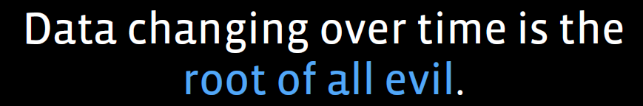
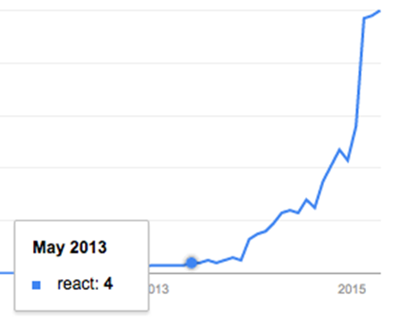
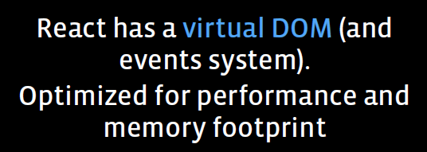
React
React Goal :
Building large applications with data
that changes over time.

Slide 6
- Declarative , immutable, Composition, Pure , Virtual DOM
- Unidirectional Data Flow
- JSX (HTML + CSS + Javascript) in XML format
- Babel transpiles to normal java script with browser compatibility
- components (Container vs Presentation)
- React Fragments
- React Portals
- React Context API
- Server Side Rendering (SSR)
Features of React 16.x

Slide 7
New Features of React 16.x
React is declarative means work without touching DOM
Imperative means work with real dom and manipulate (eg. with Jquery )

Slide 8
New Features of React 16.x
JSX — Allows us to write HTML like syntax which gets transformed to light weight JavaScript objects.
Virtual DOM — A JavaScript representation of the actual DOM.
React.Component — Describes what the UI will look like for the particular component.

Slide 9
New Features of React 16.12
Components are the building blocks of React called widgets.
Components are like angular Directives.
You can think of a component as a collection of HTML, CSS, JS, and some internal data specific to that component.
These components are defined either in pure JavaScript or using “JSX”.
JSX is compiled to pure javascript using Babel transpiler

Slide 10
Components

Slide 11
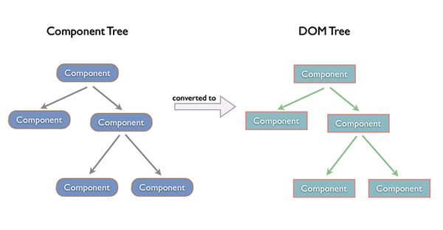
Component Tree vs DOM Tree

Slide 12
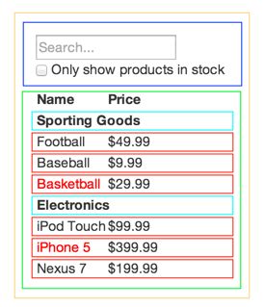
Component Tree
FilterableProductTable
SearchBar
ProductTable
ProductCategoryRow
Single Responsibility Principle
Design components to be responsible for only one thing.

Slide 13
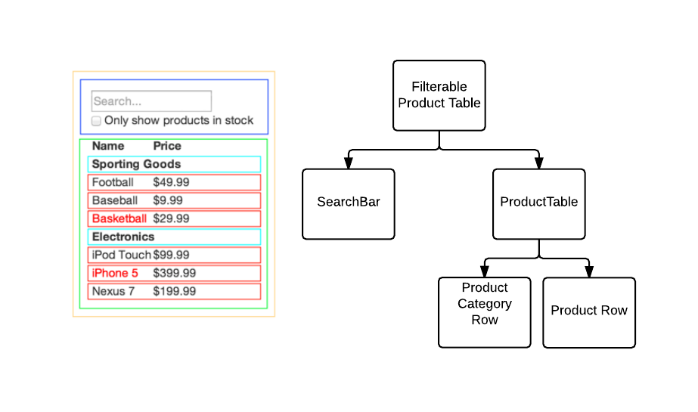
Components

Slide 14
Unidirectional Data Flow - How React works?
1. state is passed to the view and to child components from top to bottom
2. actions are triggered by the view
3. actions can update the state
4. the state change is passed to the view and to child components via props
5. Data can not flow in opposite direction and also between siblings
Advantages:
1. it’s less error prone and have more control over data
2. it’s easier to debug, as we know what is coming from where
3. it’s more efficient, as the library already knows what the boundaries are of each part of the system

Slide 15
How React works?
For Change detection:
(1) React uses an observer model instead of dirty checking (continuous model checking for changes).
That’s why it doesn't have to calculate what is changed, it knows immediately.
It reduces the calculations and make the app smoother.

Slide 16
New Features of React 16.x
Virtual DOM : for fast and minimal DOM updates:
React batches much of the changes and performs a unique update to the real DOM,
by changing all the elements that need to be changed at the same time (Diffing),
so the repaint and reflow the browser must perform to render the changes
are executed just once.

Slide 17
How React works?
For the DOM changing challenge
(2) React builds the tree representation of the DOM in the memory and calculates which DOM element should change.
DOM manipulation is heavy, and we would like to keep it at the minimum
React tries to keep as much DOM elements untouched as possible.
Given the less DOM manipulation can be calculated faster based on the object representation, the costs of the DOM changes are reduced nicely.

Slide 18
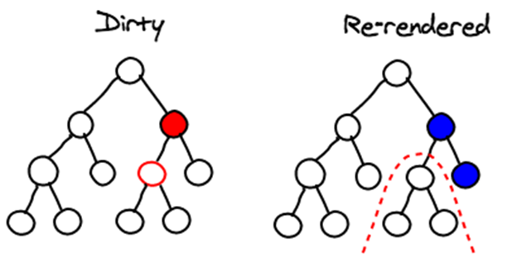
How React Works
React applies changes by running a “diffing” algorithm, which identifies what has changed.
The second step is “reconciliation”, where it updates the DOM with the results of diff.

Slide 19
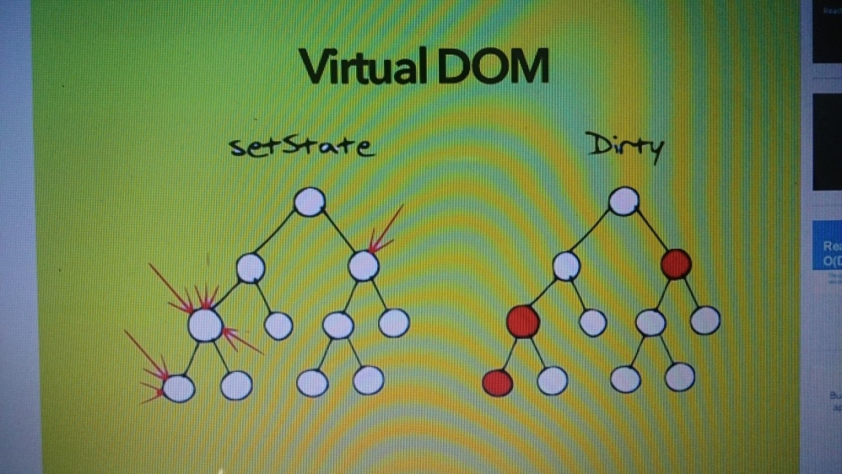
React Algorithm
The Virtual DOM
Pure render function:
f(d)=v (take data and render)
f(d’)=v’ (Data changes) - Delta
diff(v,v’)= changes (apply diff algorithm to apply DOM update where required)

Slide 20
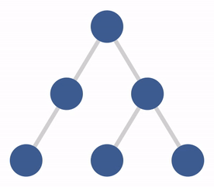
React Algorithm

Slide 21
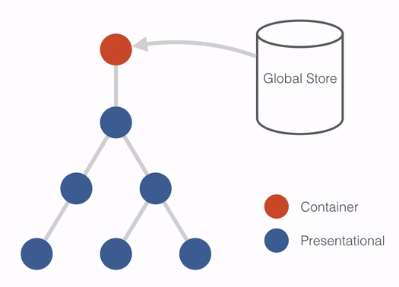
React Algorithm

Slide 22
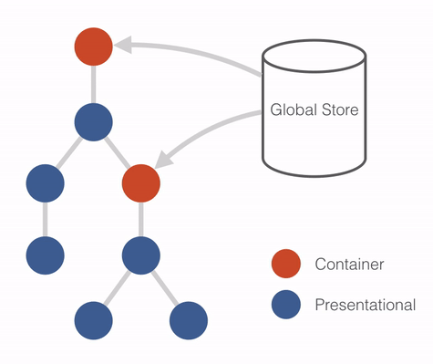
React Algorithm

Slide 23
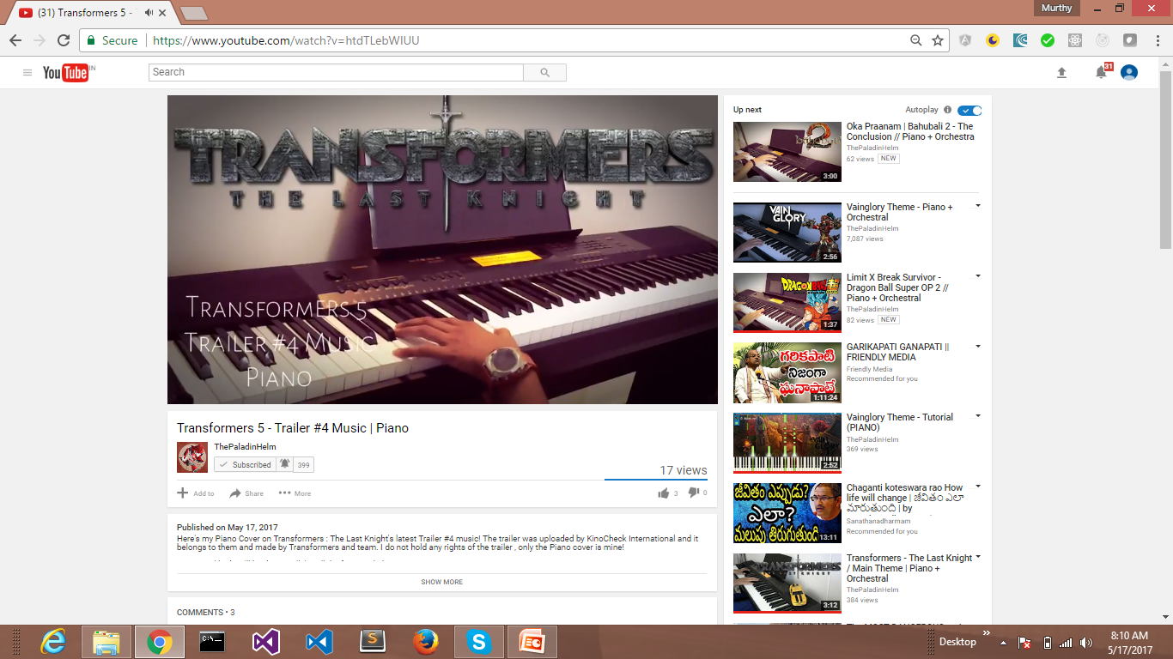
Unidirectional Data Flow
Product

Slide 24
Pure function
- when a function does not mutate objects but just returns a
new object, it’s called a pure function. (Eg. render())
No side effects
takes input and returns output without changing the input.

Slide 25
Composition
- Create specialized version of a component
- Use an outer component to expand and specialize a more generic component:
const Button = props => {
return <button>{props.text}</button>
}
const SubmitButton = () => {
return <Button text="Submit" /> }
const LoginButton = () => { return <Button text="Login" /> }

Slide 26
Composition
A component can focus on tracking a click event, for example, and what actually happens when the click event happens is up to the container component:
const Button = props => {
return <button onClick={props.onClickHandler}>{props.text}</button> }
const LoginButton = props => {
return <Button text="Login"
onClickHandler={props.onClickHandler} /> }
const Container = () => {
const onClickHandler = () => {
alert('clicked') }
return <LoginButton onClickHandler={onClickHandler} />
}

Slide 27
props.children
The props. Children property allows to inject components
inside other components.
The component needs to output props.children in its JSX:
const Sidebar = props => {
return <aside>{props.children}</aside>
}
Now embed more components into it in a transparent way:
<Sidebar>
<Link title="First link" />
<Link title="Second link" />
</Sidebar>

Slide 28
Component
- Reusable peace of UI widget enpasulates UI behaviour with it's own state.
Functional component vs Class Component
---------------------------------------------------
//Functional Component
export const Greet= (props) => { return ( <div>Hello</div> ) }
// stateless Functional Component

Slide 29
Component
The state can be mutated by a child component by passing a mutating function down as a prop
import React, { Component } from 'react'
class Greet extends Component {
constructor(props){
super(props)
this.state={data:'Hello'}
}
// this.state.data="Welcome" // error as state can not be mutated directly
// this.setState({data:'Welcome'})
render() {
return ( <div>{this.state.data}</div> )
}
}

Slide 30
props
Component gets their properties via props from its parent which is accessible in child via props.data(Functional Component through props parameter) or this.props.data(Class Component)
DefaultProps and PropTypes:
class Blog.... { }
Blog.propTypes = { title: PropTypes.string, description: PropTypes.string }
// Validation
Blog.defaultProps = { title: '', description: '' }
// Set the default values for props

Slide 31
Presentation vs Container Component
Presentational components are concerned with generating some markup to be outputted. They don’t manage any kind of state
Container components are mostly concerned with the “backend”
operations with state management (Interface with Redux / Mobx ).
Handle various sub-components (Presentations )
Presentational components are concerned with the look,
container components are concerned with making things work. (Smart)

Slide 32
React.Fragment
class Blog extends Component {
render() {
return (
<React.Fragment> or <>
<h1>Hi!</h1>
<p>Welcome to React</p>
</React.Fragment> </>
)}
}

Slide 33
Component Life cycle
1. Mounting
constructor(), getDerivedStateFromProps(), render() and componentDidMount()
2. Updating
getDerivedStateFromProps(), shouldComponentUpdate(),
render(), getSnapshotBeforeUpdate() and componentDidUpdate()
3. Unmouting
componentWillUnmount()
4. Error handling
componentDidCatch()
componentWillMount, componentWillReceiveProps or componentWillUpdate
are obsolete from 16.3 version onwards.

Slide 34
Higher order functions
Higher Order Functions in JavaScript are functions that accept
functions as arguments, and/or return function. (Array.map, Array.filter)
When the component accepts a component as input
and returns a component as its output, it is HOC.
It is for composable and reusable, and also more encapsulated.

Slide 35
Higher order functions
Use HOC to enhance an existing component,
operate on the state or props, or its rendered markup. (Eg. Apply themes)
Start HOC using with (convention). Example
const withElement = Element => () => &lt;Element />

Slide 36
Higher order functions
// add color property to component (ex button)
const withColor = (Element) => (props) => <Element {...props} color="red" />
const Button = () => { return <button >click</button> }
const ColoredButton = withColor(Button)
// In redux, connect is HOC ➔ connect(ProductComponent)
function App() {
return (
<>
<ColoredButton />
</> )
}
.

Slide 37
React ingradients
Node js > 10.x (npx and yarn)
Webpack / Gulp / Grunt for Build automation
HTML 5 with API (LocalStorage)
CSS 3 and Bootstrap , React-bootstrap for responsive design
ES 6.0 and ES2017 loader for transpilation
React and Redux /Mobx with create-react-app tool
React , redux dev tools or Mobx dev tool for debugging
Redux middleware (Logger, Thunk, Saga, …..)
Visual Studio Code IDE / ATOM …..
JEST unit testing framework
Deployment tools – Jenkins / GIT

Slide 38
React project setup
$ npm install create-react-app -g
$ create-react-app react-app
cd react-app
npm start
Open the project in IDE (VS Code)
Or use online editor
https://stackblitz.com/

Slide 39
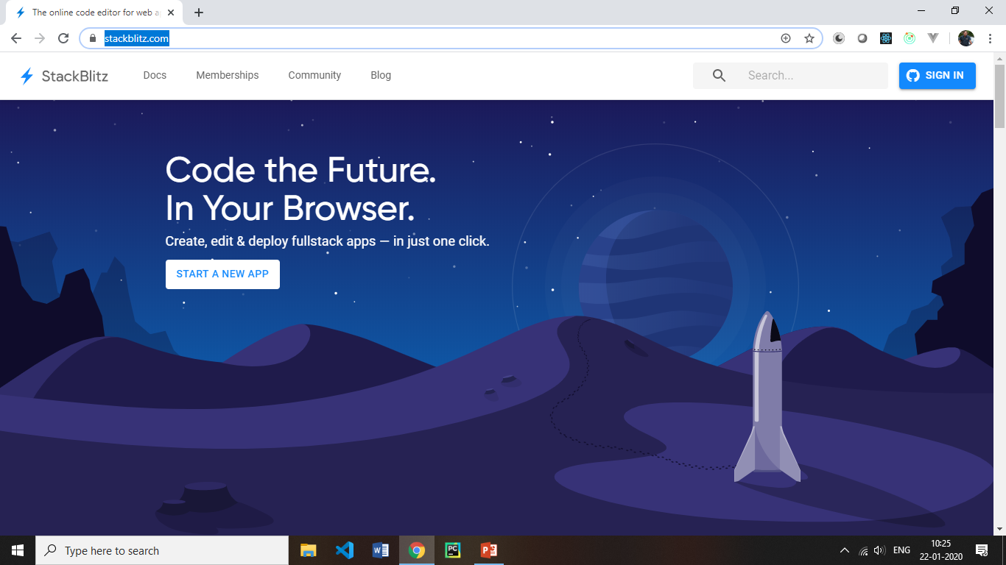
React ingradients
$ create-react-app react-app
cd react-app
npm start

Slide 40
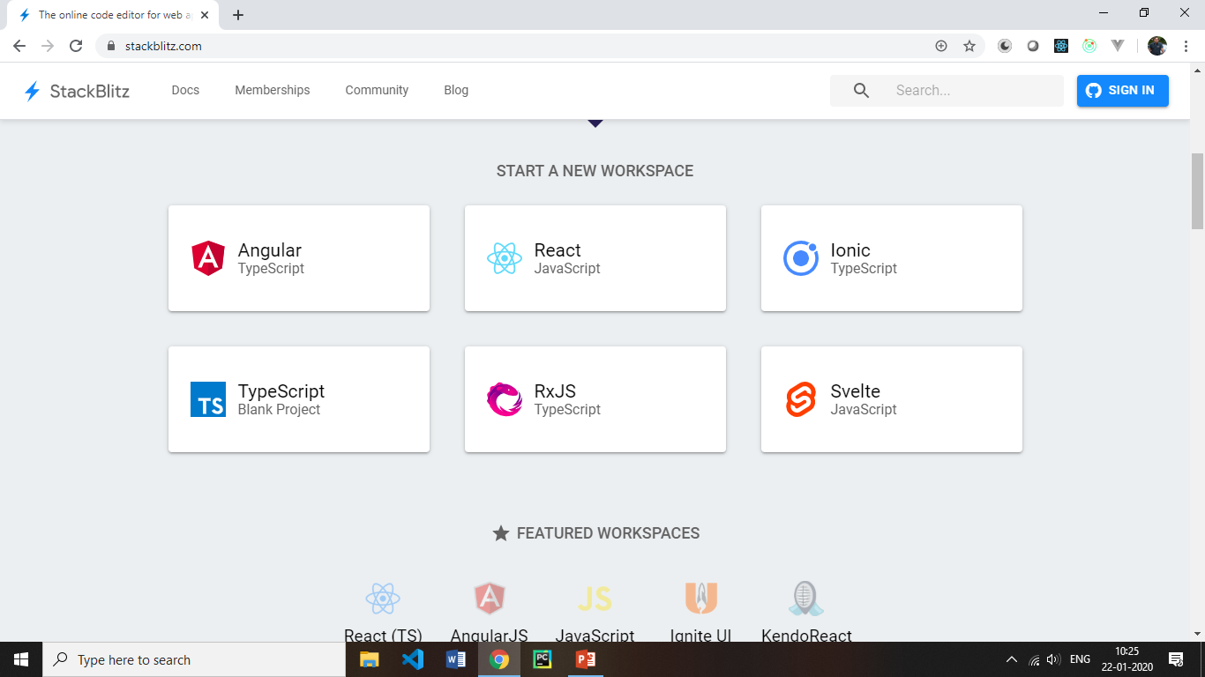
React ingradients
$ create-react-app react-app
cd react-app
npm start

Slide 41
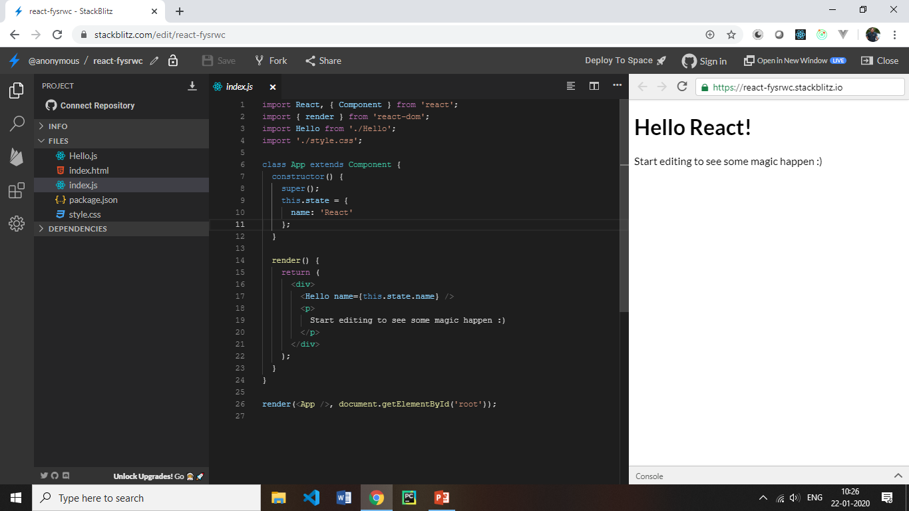
React ingradients
$ create-react-app react-app
cd react-app
npm start

Slide 42
Editors for React JS
Sublime Text 3.0 with Babel plugin
Eclipse
Visual Studio 2013
Jet Brains
JS Fiddle
https://jsfiddle.net/guillaumemaka/jwm6k66c/
(Google search: react fiddle to get above link)

Slide 43
Build tools / Bundlers with HMRE
Install node js from nodejs.org
C:\> node -version
C:\>npm install create-react-app -g
C:\>create-react-app reactproject

Slide 44
JSX – JavaScript and XML
JSX is a XML-like syntax extension to ECMAScript.
React provides a convenient XML-based extension to JavaScript, called JSX, to build the component tree as a set of XML nodes.
JSX simplifies the association of event-handlers and properties as xml attributes.
A JSX XML node maps directly to a Component.
Because JSX is not supported in browsers by default we have to compile it to JS.
(Babel can transpile JSX to JS).

Slide 45
React Redux case study

Slide 46
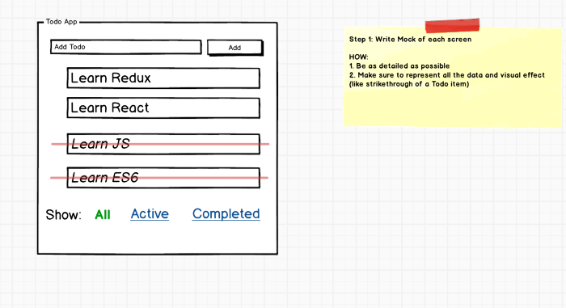
STEP 1 — Write A Detailed Mock of the Screen
Mock should include all the data and visual effects

Slide 47
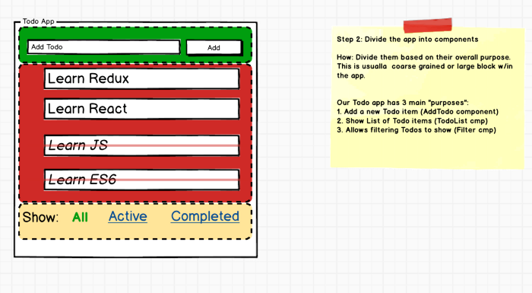
STEP 2 — Divide The App Into Components
3 components “AddTodo”, “TodoList” and “Filter” component.
Redux Terms: “Actions” And “States”
Every component does two things: 1. Render DOM based on some data. This data is called as a“state”. 2. Listen to the user and other events and send them to JS functions. These are called “Actions”.

Slide 48
React Component Tree
Store
Todoapp
AddTodo
Todolist
Filter
Todo
text
Add
TodoItem
All
Show
done

Slide 49
STEP 3 — List State and Actions For Each Component
Make sure to take a careful look at each component from STEP 2, and list of States and Actions for each one of them.
We have 3 components “AddTodo”, “TodoList” and “Filter” component. Let’s list Actions and States for each one of them.
3.1 AddTodo Component — State And Actions
In this component, we have no state since the component look and feel doesn’t change based on any data but it needs to let other components know when the user creates a new Todo. Let’s call this action “ADD_TODO”.
.

Slide 50
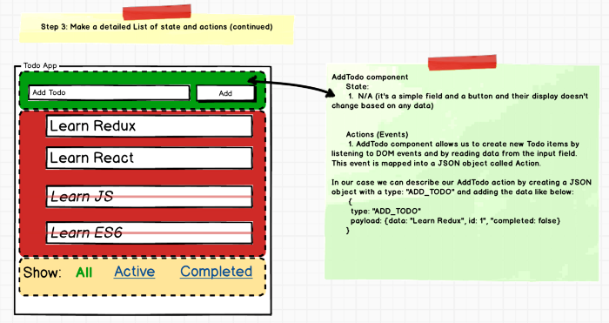

Slide 51
3.2 TodoList Component — State And Actions
TodoList component needs an array of Todo items to render itself, so it need a state, let’s call it Todos (Array).
It also needs to know which “Filter” is turned on to appropriately display (or hide) Todo items, it needs another state, let’s call it “VisibilityFilter” (boolean).
it allows us to toggle Todo item’s status to completed and not completed.
We need to let other components know about this toggle as well. Let’s call this action “TOGGLE_TODO”
.

Slide 52
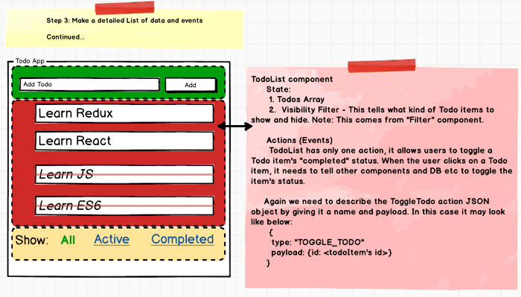
3.2 TodoList Component — State And Actions

Slide 53
3.3 Filter Component — State And Actions
Filter component renders itself as a Link or as a simple text depending on if it’s active or not.
Let’s call this state as “CurrentFilter”.
Filter component also needs to let other components know when a user clicks on it. Let’s call this actions, “SET_VIBILITY_FILTER”
.

Slide 54
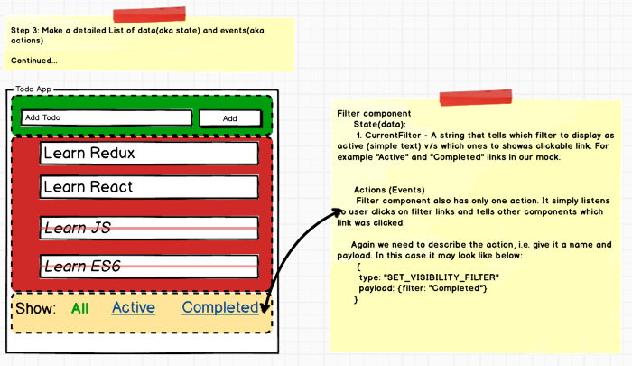
3.3 Filter Component — State And Actions

Slide 55
STEP 4 — Create Action Creators For Each Action
We have total 3 actions: ADD_TODO, TOGGLE_TODO and SET_VISIBILITY_FILTER.
Redux Term: “Reducers”
Reducers are functions that take “state” from Redux and “action” JSON object and returns a new “state” to be stored back in Redux. 1. Reducer functions are called by the “Container” containers when there is a user action. 2. If the reducer changes the state, Redux passes the new state to each component and React re-renders each component

Slide 56
STEP 5 — Write Reducers For Each Action
Redux Term: “Presentational” and “Container” Components
Keeping React and Redux logic inside each component can make it messy, so Redux recommends creating a dummy presentation only component called “Presentational” component and a parent wrapper component called “Container” component that deals w/ Redux, dispatch “Actions” and more. The parent Container then passes the data to the presentational component, handle events, deal with React on behalf of Presentational component.

Slide 57
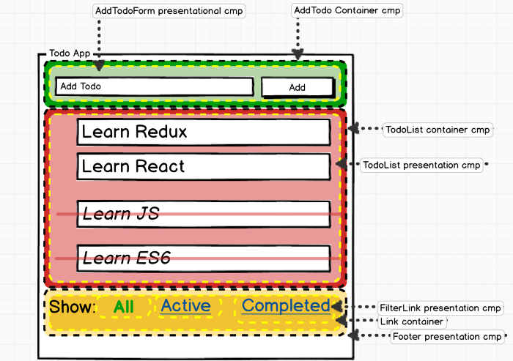

Slide 58
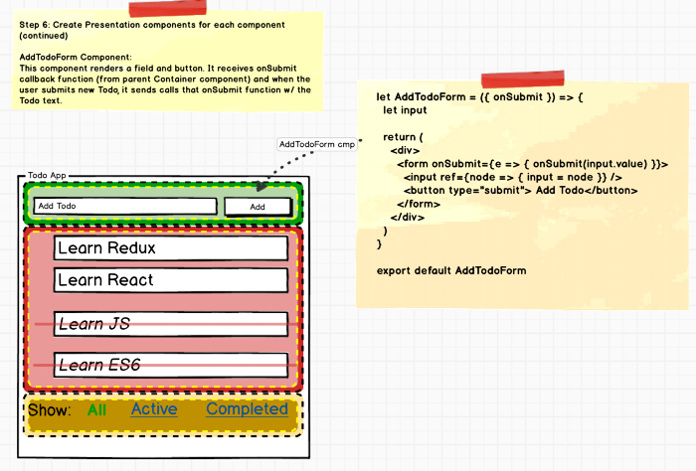
6.1 — Implement AddTodoForm Presentational Component

Slide 59
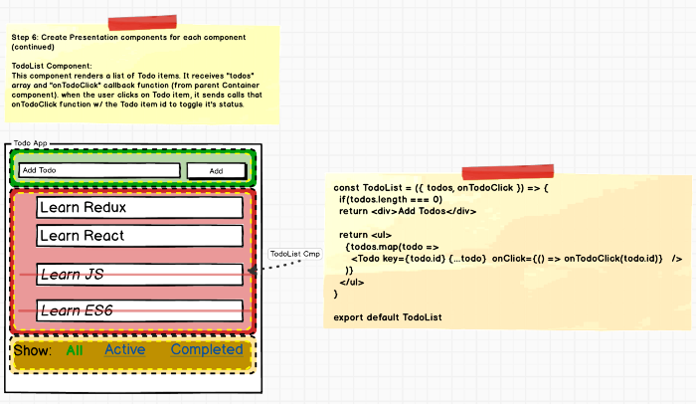
6.2 — Implement TodoList Presentational Component

Slide 60
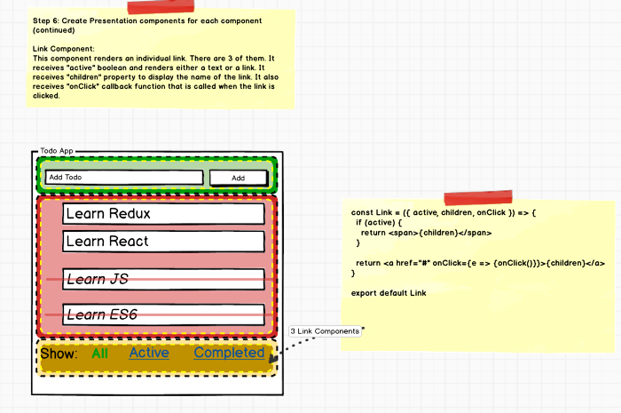
6.3 — Implement Link Presentational Component

Slide 61
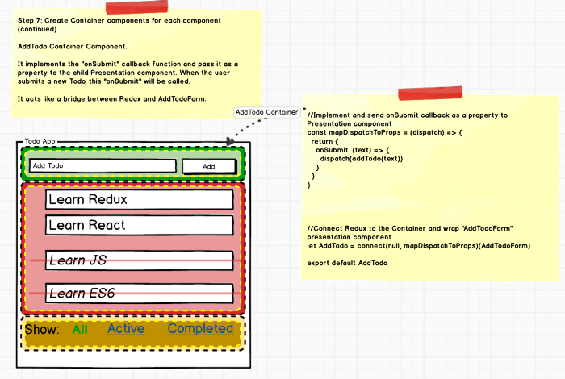
STEP 7 — Create Container Component
7.1 Create Container Component — AddTodo

Slide 62
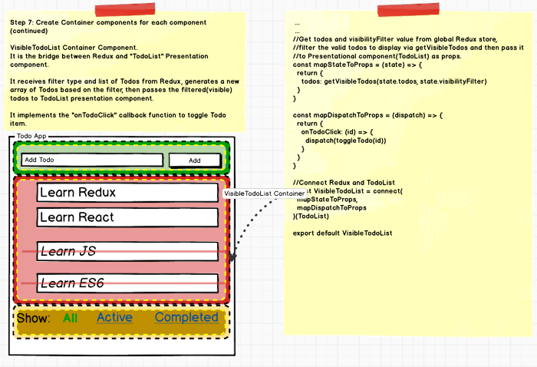
7.2 Create Container Component — TodoList Container

Slide 63
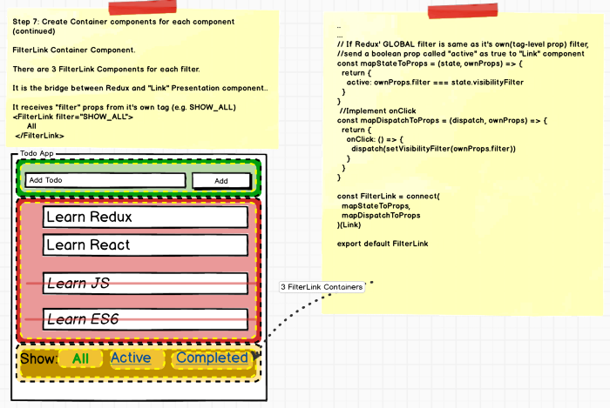
7.3 Create Container Component — Filter Container

Slide 64
STEP 8 — Finally Bring Them All Together

